Slide 1


Interfaces and Abstraction
Abstraction, Polymorphism - Interfaces
SoftUni Team
Technical Trainers
Software University
https://softuni.bg

Slide 2
Table of Contents
Fundamental Principles
Abstraction
Hide complexity
Polymorphism
Abstract Classes
Interfaces
Namescapes
2

Slide 3

Fundamental Principles
OOP

Slide 4
Fundamental Principles of OOP
Abstraction
Hide complexity
Encapsulation
Hide internal data
Inheritance
Inherit members from parent class
Polymorphism
Different functionality while sharing a common interface
4

Slide 5

Abstraction

Slide 6
What is Abstraction?
An abstraction includes the essential details relative to the perspective of the viewer
Hides all but the relevant data about an object in order to reduce complexity and increase efficiency
Abstraction is a concept that takes places anywhere in a software system more general/simpler is involved
6

Slide 7
What is Abstraction?
An inheritance hierarchy, where the higher classes are simpler or more general
Define more general and abstract implementation
Using encapsulation to hide the details of implementation of a class from other classes

Slide 8
Abstraction – Example
Let's take DateTime class as an example
We know how to use the methods without worrying how they do their job
DateTime implements DateTimeInterface {
public DateTime add(DateInterval $interval)
public DateTime setTimestamp(int $unixtimestamp)
public DateTime setTimezone(DateTimeZone $timezone)
public DateInterval diff(DateTimeInterface $datetime2 [, bool $absolute = false ])
}

Slide 9



Polymorphism

Slide 10
What is Polymorphism?
Polymorphism is the ability to take on many forms
A child class may override (change) some of the parent's methods
In the programming world, polymorphism is used to make applications more modular and extensible
10

Slide 11
What is Polymorphism?
The code working with the different classes does not need to know which class it is using since they are all used the same way
Same objects with the same interfaces have different implementation on that interface

Slide 12



Abstract Classes

Slide 13
Abstract Classes
An abstract class is a mix between an interface and a class
It can define functionality as well as interface (in the form of abstract methods)
Classes extending an abstract class must implement all the abstract methods defined in the abstract class
abstract class MyAbstract {
// methods
}
13

Slide 14
Extending Abstract Class
Abstract classes cannot be instantiated
Extending an abstract class is the same as with regular one
abstract class MyAbstract {
// Methods
}
$abstract = new MyAbstract();
// Uncaught Error: Cannot instantiate abstract class
class MyClass extends MyAbstract {
// Methods
}

Slide 15
Methods in Abstract Class
Regular methods can be defined in an abstract class
Abstract methods, using the abstract keyword
abstract class MyAbstract {
private $name;
public function doThis() {
// Do this
}
abstract public function doThat();
abstract public function setName($name);
}

Slide 16

Interfaces

Slide 17
What is an Interface?
An integral part of polymorphism is the common interface
Defining an interface is easy
Attach it to a class using the implements keyword
interface MyInterface {
// Methods
}
class MyClass implements MyInterface {
// Methods
}
17

Slide 18
Interface Details
Interfaces can be extended like classes using the extends operator
The class implementing the interface must use the exact same method signatures as are defined in the interface
Interfaces can have constants
They works exactly like class constants except
Cannot be overridden by a class/interface that inherits them

Slide 19
Interface Example
Methods can be defined in the interface just like in a class, except without the body
All methods defined here will need to be included in any implementing classes exactly as described
interface MyInterface {
public function doThis();
public function doThat();
public function setName($name);
}
All methods declared in an interface must be public

Slide 20
Interface Valid Example
class MyClass implements MyInterface {
protected $name;
public function doThis() {
// Code that does this
}
public function doThat() {
// Code that does that
}
public function setName($name) {
$this->name = $name;
}
}
All methods included correctly

Slide 21
Interface Invalid Example
class MyClass implements MyInterface {
// Missing doThis()!
private function doThat() {
// This should be public!
}
public function setName() {
// Missing the name argument!
}
}
All methods not included correctly

Slide 22
Identify the Problem
Imagine that you have an Article class that is responsible for managing articles on your website
class Article {
private $title;
private $author;
private $date;
private $category;
// Continues on next slide

Slide 23
Identify the Problem (2)
public function __construct($title, $author, $date, $category = 0) {
$this->title = $title;
$this->author = $author;
$this->date = $date;
$this->category = $category;
}
}

Slide 24
Identify the Problem (3)
Now you want to add a method to output the information into different formats, such as XML and JSON
You might be tempted to do something like this
class Article {
public function write($type) {
$ret = '';
switch($type) {
case 'XML':
$ret = '<article>';
$ret .= '<title>'.$this->title.'</title>';
// Continues on next slide
Using switch to determine type is ugly, do not do this

Slide 25
Identify the Problem (4)
$ret .= '<author>'.$this->author.'</author>';
$ret .= '<date>'.$this->date.'</date>';
$ret .= '<category>'.$this->category.'</category>';
$ret .= '</article>';
break;
case 'JSON':
$array = ['article' => $this];
$ret = json_encode($array);
break;
}
return $ret;
}
}

Slide 26
What is the Problem with This Solution?
This is kind of an ugly solution, but it works - for now
Ask yourself what happens in the future, though, when we want to add more formats?
You can keep editing the class, adding more and more cases, but now you're only diluting your class
One important principle of OOP is that a class should do one thing, and it should do it well

Slide 27
Solution: Define Your Interface
Let's define a public write() method that accepts an Article object as an argument
Any classes implementing the Writer interface will be sure to have this method
interface Writer {
public function write(Article $obj);
}

Slide 28
Solution: Create Your Implementation
class newXMLWriter implements Writer {
public function write(Article $obj) {
$ret = '<article>';
$ret .= '<title>'.$obj->title.'</title>';
$ret .= '<author>'.$obj->author.'</author>';
$ret .= '<date>' . $obj->date . '</date>';
$ret .= '<category>'.$obj->category.'</category>';
$ret .= '</article>';
return $ret;
}
}
Our newXMLWriter using Writer Interface

Slide 29
Solution: Create Your Implementation (2)
Now here is our JSONWriter class
All our code specific to each format is now contained within individual classes
class JSONWriter implements Writer {
public function write(Article $obj) {
$array = ['article' => $obj];
return json_encode($array);
}
}

Slide 30
Solution: Use the Implementation
With our new classes defined, it is time to revisit our Article class
class Article {
// ...
public function write(Writer $writer) {
return $writer->write($this);
}
}
Replace our write method with the new one

Slide 31
Solution: Obtaining a Writer
Create a factory class to grab request data and create an object
class Factory {
public static function getWriter($name) {
$class = $name . 'Writer';
if (class_exists($class)) {
return new $class();
}
throw new Exception('Unsupported format');
}
}
A method called without an instance of the class

Slide 32
Put It All Together
$article = new Article('Polymorphism', 'Steve', time(), 0);
try {
$writer = Factory::getWriter('JSON');
} catch (Exception $e) {
$writer = new newXMLWriter();
}
echo $article->write($writer);

Slide 33
Abstract Classes vs. Interfaces
Interfaces
Can include abstract methods and constants
Cannot contain concrete methods and variables
All the methods in the interface must be in the public visibility scope
A class can implement more than one interface, while it can inherit from only one abstract class

Slide 34
Abstract Classes vs. Interfaces
 | interface | abstract class
the code | - abstract methods - constants | - abstract methods - constants - concrete methods - concrete variables
access modifiers | - public | - public - protected - private
number of parents | The same class can implement more than 1 interface | The child class can inherit only from 1 abstract class

Slide 35
Multiple Interfaces
Class could implement more than one interface
Class could implement two interfaces that specified a methods with the same name only if they have the same signature
interface SaveData{
public function Save{array $data};
}
interface DeleteData{
public function Delete{int $id};
}

Slide 36
Multiple Interfaces (2)
class ManageData implements SaveData,DeleteData {
public function Save(array $data) {
// ...
}
public function Delete(int $int) {
// ...
}
}

Slide 37
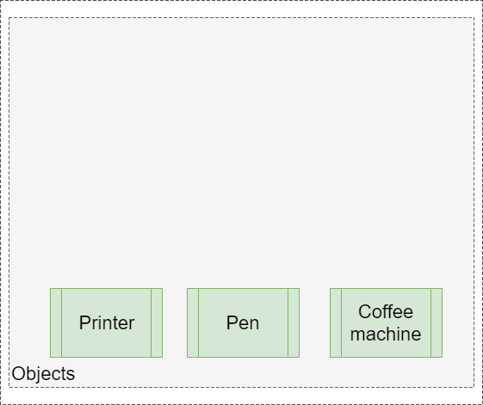
Interfaces with Multi Implementations

Slide 38
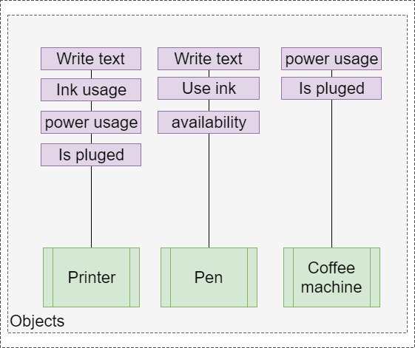
Interfaces with Multi Implementations

Slide 39
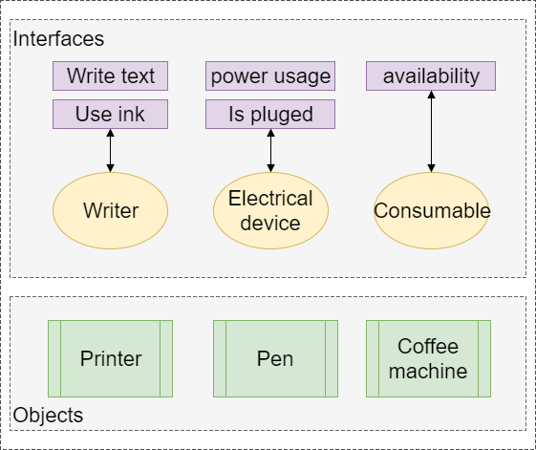
Interfaces with Multi Implementations

Slide 40
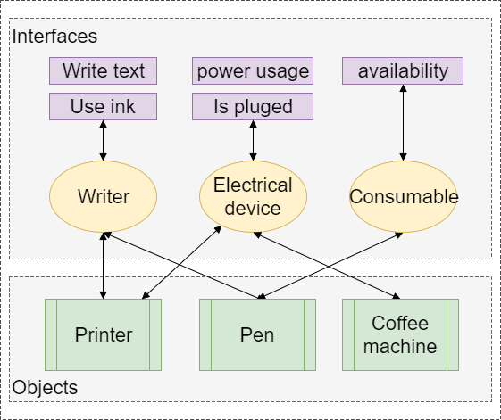
Interfaces with Multi Implementations

Slide 41

Namespaces
Using Namespaces

Slide 42
Namespaces
Namespaces are used to group code around a functionality
Better structure for your code, especially in big projects
Classes, functions, etc. in a namespace are automatically prefixed with the name of the namespace
use CalculationsManager;
$interest = CalculationsManager\getCurrentInterest();
$mysqli = new \mysqli("localhost", "root", "", "world");

Slide 43
Namespaces – Example
<?php
namespace SoftUni {
function getTopStudent() {
return "Pesho";
}
}
namespace NASA {
use SoftUni;
$topSoftUniStudent = SoftUni\getTopStudent();
echo $topSoftUniStudent; // Pesho
}
?>
Declares the use of given namespace
Uses a function from the SoftUni namespace

Slide 44
Namespaces – Example (2)
Define the class in separate file
namespace SoftUni;
class Student {
private $fname = "Gosho";
private $lname = "Pesho";
public function printNames() {
echo $this->fname . $this->lname . "\n";
}
}

Slide 45
Namespaces – Example (2)
Include the previous file
namespace SoftUni2;
require_once 'softuni.php';
use SoftUni\Student;
function createStudent() {
$student = new Student('Gosho', 'Petrov');
return $student;
}
print_r(createStudent());

Slide 46

Summary
…
…
…
Abstraction is essential details relative to the perspective of the viewer
Polymorphism - Same objects with the same interfaces have different implementation on that interface
Namespaces are used to group code around a functionality

Slide 47
Questions?
Notes:
47

Slide 48
Trainings @ Software University (SoftUni)
Software University – High-Quality Education, Profession and Job for Software Developers
about.softuni.bg, softuni.org
Software University Foundation
softuni.foundation
Software University @ Facebook
facebook.com/SoftwareUniversity
Software University Forums
forum.softuni.bg
48
Notes:
48

Slide 49

License
This course (slides, examples, demos, exercises, homework, documents, videos and other assets) is copyrighted content
Unauthorized copy, reproduction or use is illegal
© SoftUni – https://about.softuni.bg
© Software University – https://softuni.bg
Notes:
49

